Slide 1
Friendly Water for the World
Plan to Improve FWW’s Social Media Strategy

Slide 2
Facebook Posts

Slide 3
Facebook Posts
Grab the reader’s attention in the first line
If possible, make media such as pictures, video, or music the focal point of the post
Try and limit posts to 40 words or less
  While this can be difficult, research shows that most users stop reading a post after 40 characters-- less than your average sentence
  It is important to get your point across as quickly as possible
    Pictures and video are useful for this as they can tell a story quickly

Slide 4
Facebook Posts
Limit the length of posts and encourage users to visit the website
  This will increase website traction
    The website should be the platform with the most in-depth information
  People are more likely to donate when on the website
While repetition helps users remember many pages it is unnecessary to being every post with FRIENDLY WATER FOR THE WORLD
  This can be overbearing and put readers off

Slide 5
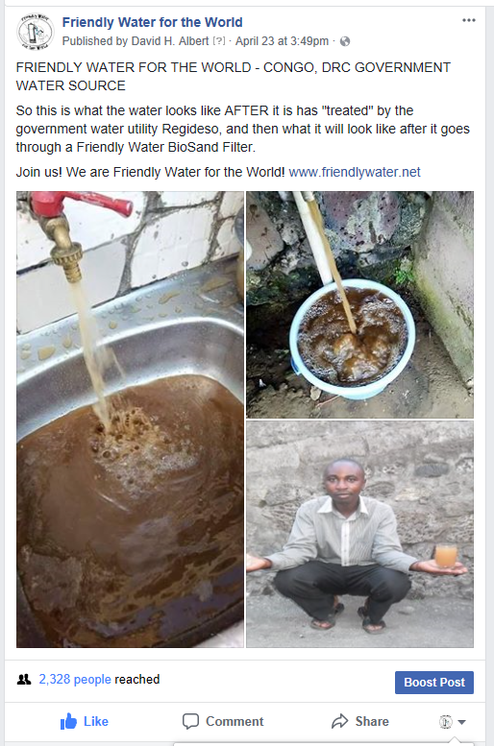
Facebook Posts
This is an example of a great post
  The CAPITAL letters grab the reader’s attention
  It is brief
  Users are directed to the website
  There is supplemental media (showing is better than telling)
However, the FRIENDLY WATER FOR THE WORLD at the beginning is unnecessary

Slide 6
Facebook Events

Slide 7

Facebook Events
Facebook Events can be a great way to increase awareness and attendance of a FWW event. However, this requires a lot of attention and care
Always make sure the event picture is informative and eye-catching
  Dimensions for event picture:
    785×295 pixels – for the event page
    470×174 pixels – for the Newsfeed
    150×100 pixels- for the upcoming events section

Slide 8
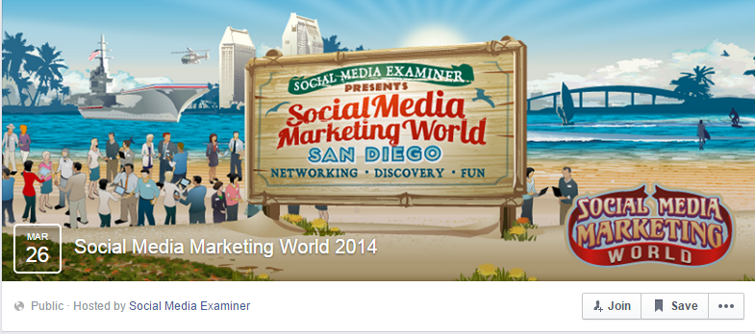
Facebook Events
Example of a great ad banner:

Slide 9
Facebook Events
Connect with users inside the event
  If a user says “yes” or “maybe” to attending the event, like their status or leave a comment
    This will further their chances of attending and their likeliness to share the event with others
  If there is any activity on the event page (likes, comments or shares) engage with the users.
    Like, share, or comment on their activity
    This increases the sense of community
Though this may seem trivial or tedious, this is SUPER important and increases the “activity” level of a page which directly impacts its traction on Facebook. This means more people will see this event within FWW’s community and without

Slide 10
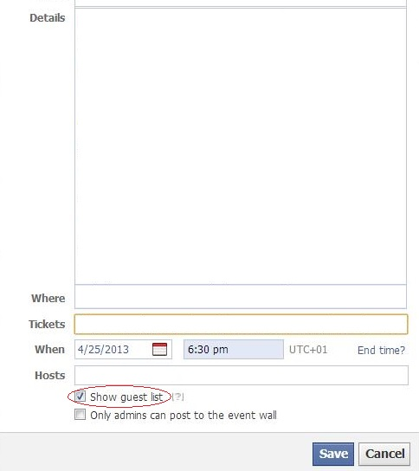
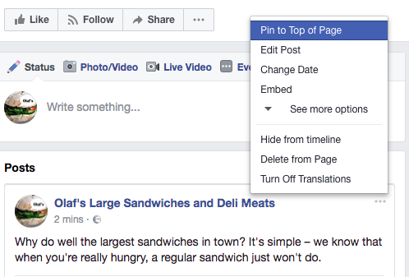
Facebook Events
Always remember to show RSVP’s for your event and pin the event to the top of the FWW page

Slide 11
Facebook Events
Share the event with the personal profiles of FWW workers, volunteers, and users attending the event
  Start with the usual. Share the event on your own Facebook page, and then send out invitations to people in your circle.
  Encourage those who are attending to share the event and invite their friends (with suggestions feature, people can invite more people than they could before).
  These actions help you make sure you spread the event as far as possible.

Slide 12
Facebook Ads

Slide 13
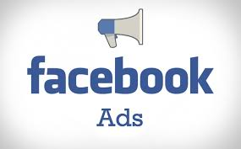
Facebook Ads
Before FWW creates or distributes Facebook ads a plan must be established for each ad. This plan should consider:
What is the central message of this ad?
What is the call to action?
  Increase followers on social media
  Encourage followers to share your page
  Visit your website
  Attend an event
  Donate
  Etc.
Who is the target audience of this ad?

Slide 14
Facebook Ads
The strategies outlined for Facebook posts also apply to Facebook ads
Limit the text length
  If you can convey a message with a video, picture, or poster DO IT! People don’t really enjoy reading-- they really don’t like reading ads
  Try and limit the text to one sentence and the link for the FWW website
Always use media to convey a message

Slide 15
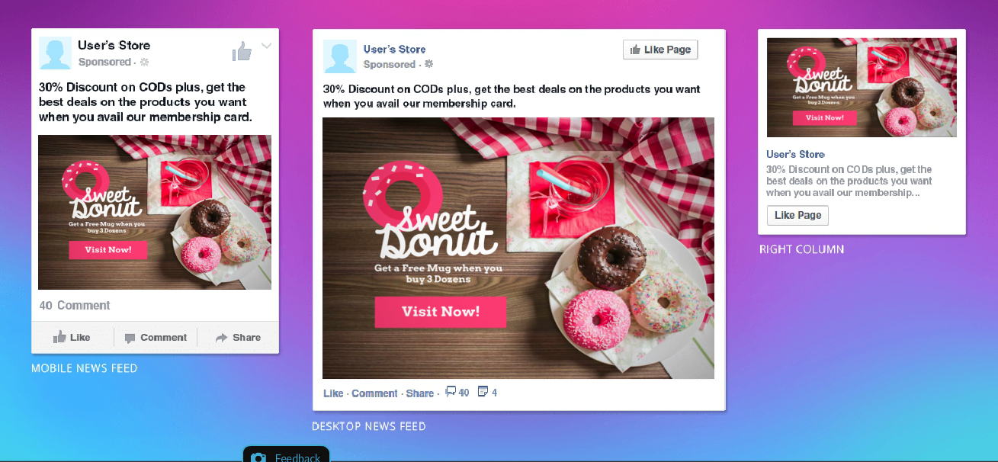
Facebook Ads
This is an example of a great Facebook ad that FWW can recreate

Slide 16
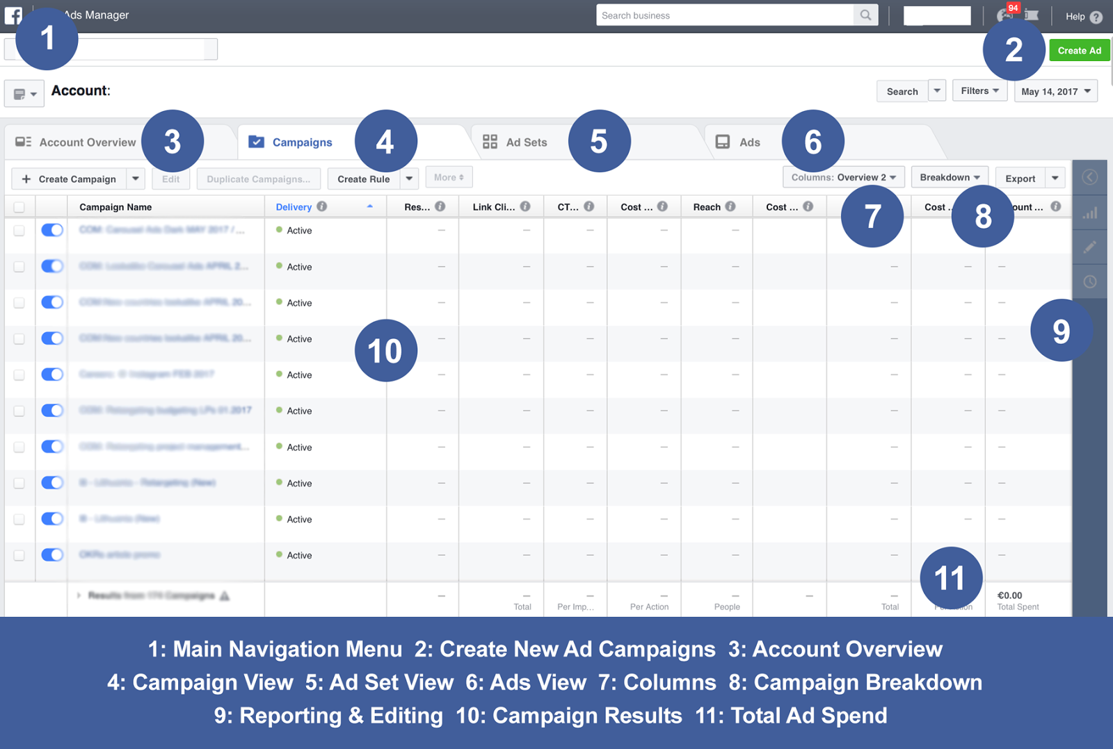
Facebook Ads
Basics of the Ads Manager Account

Slide 17
Steps for Creating a Facebook Ad

Slide 18
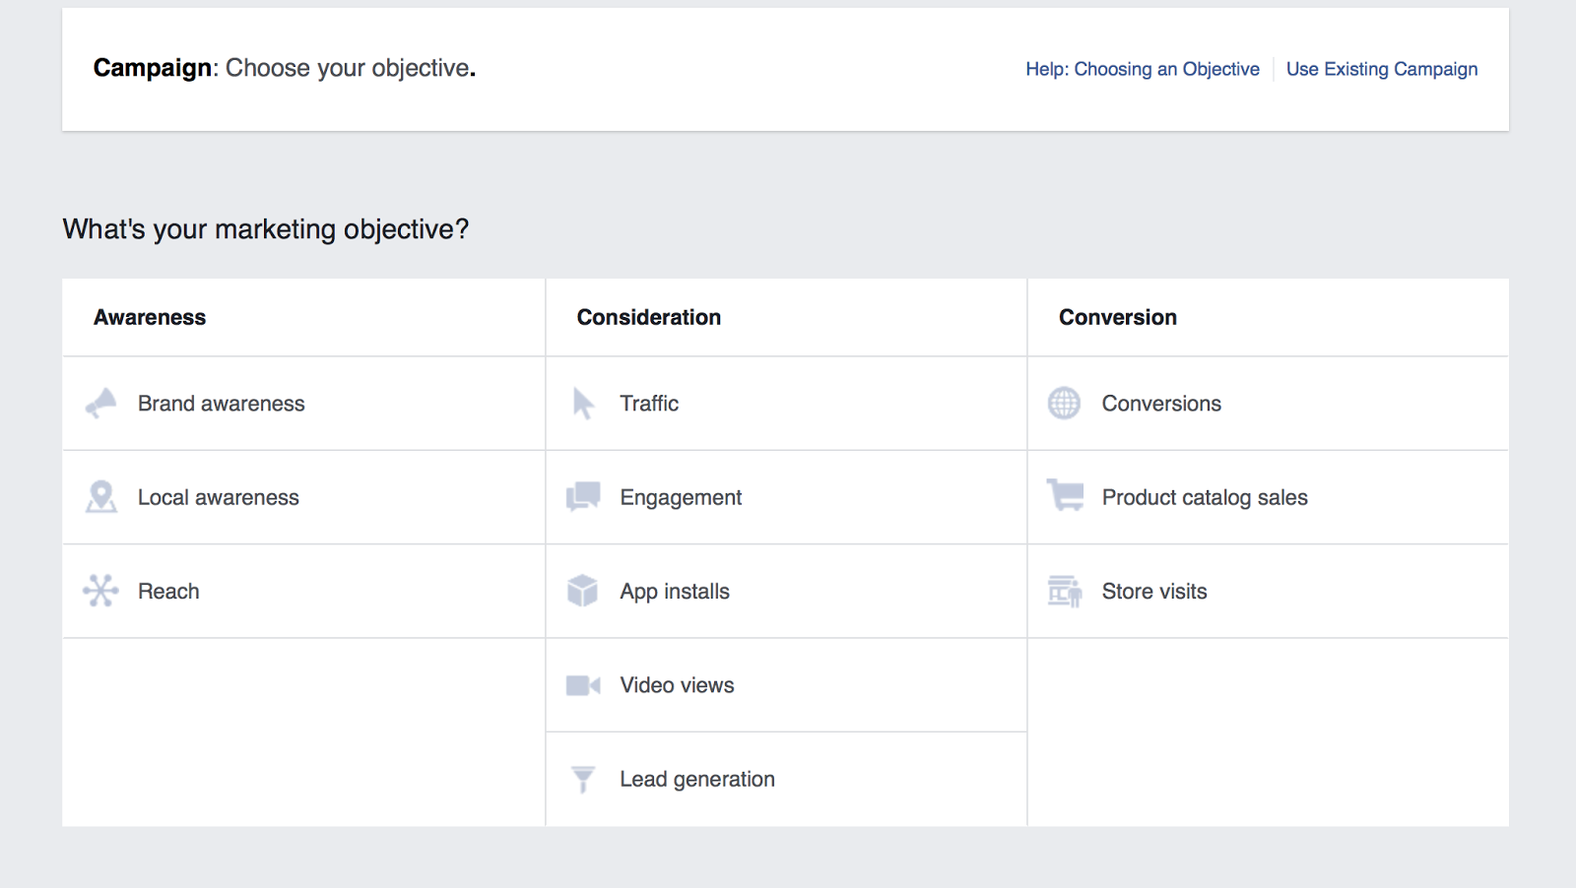
Step 1: Select Your Campaign Objective

Slide 19
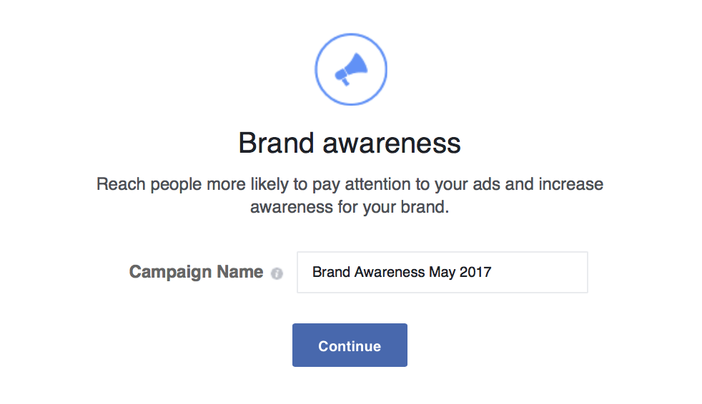
Step 2: Give Ad Campaign a Name
When naming your Facebook ad campaign, don’t forget to add the date range so that it will be easier to navigate between your campaigns later.

Slide 20
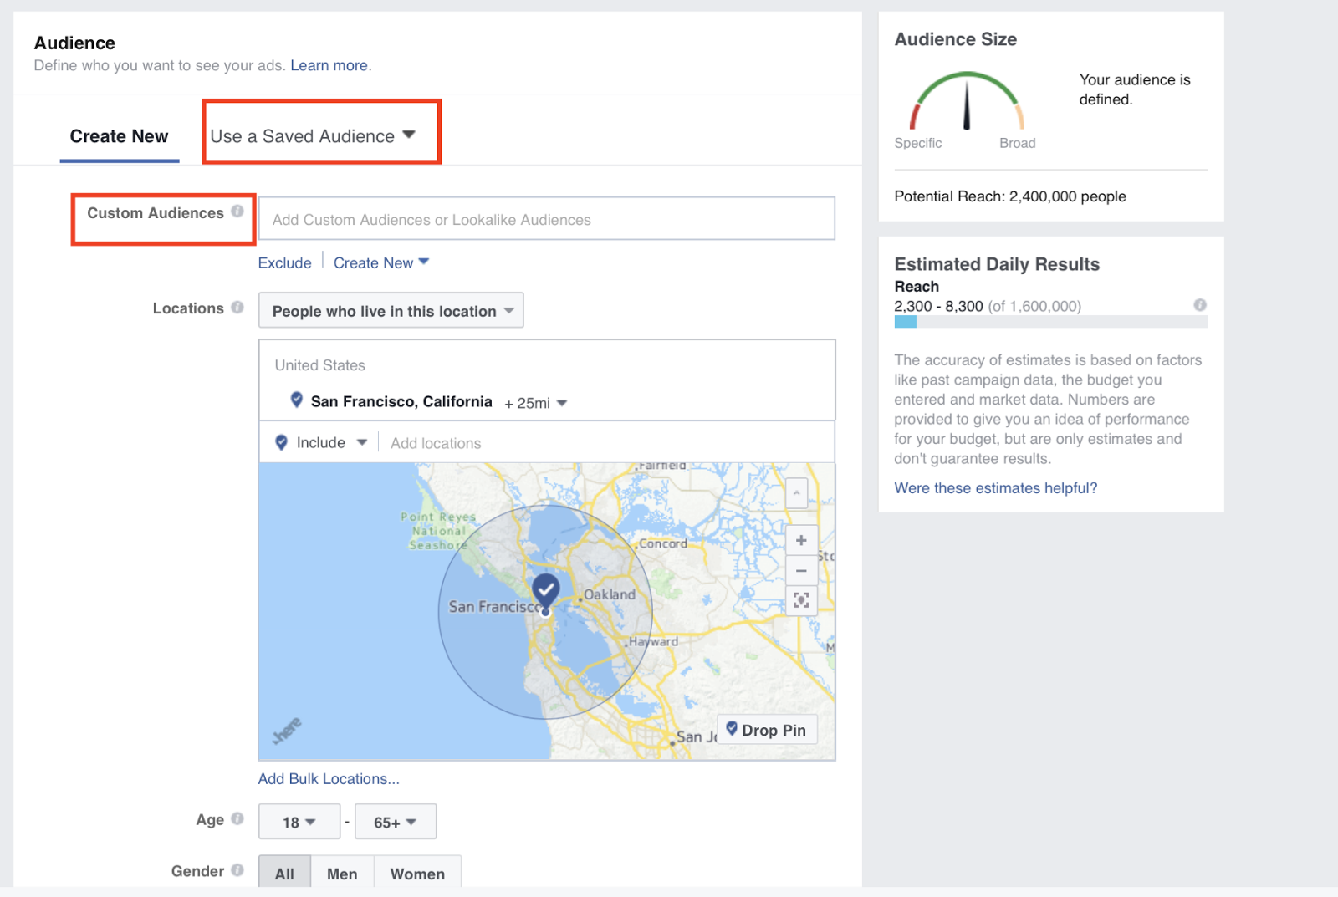
Step 3: Set Up Audience Targeting
This is really important and should be well thought-out depending on the ad

Slide 21
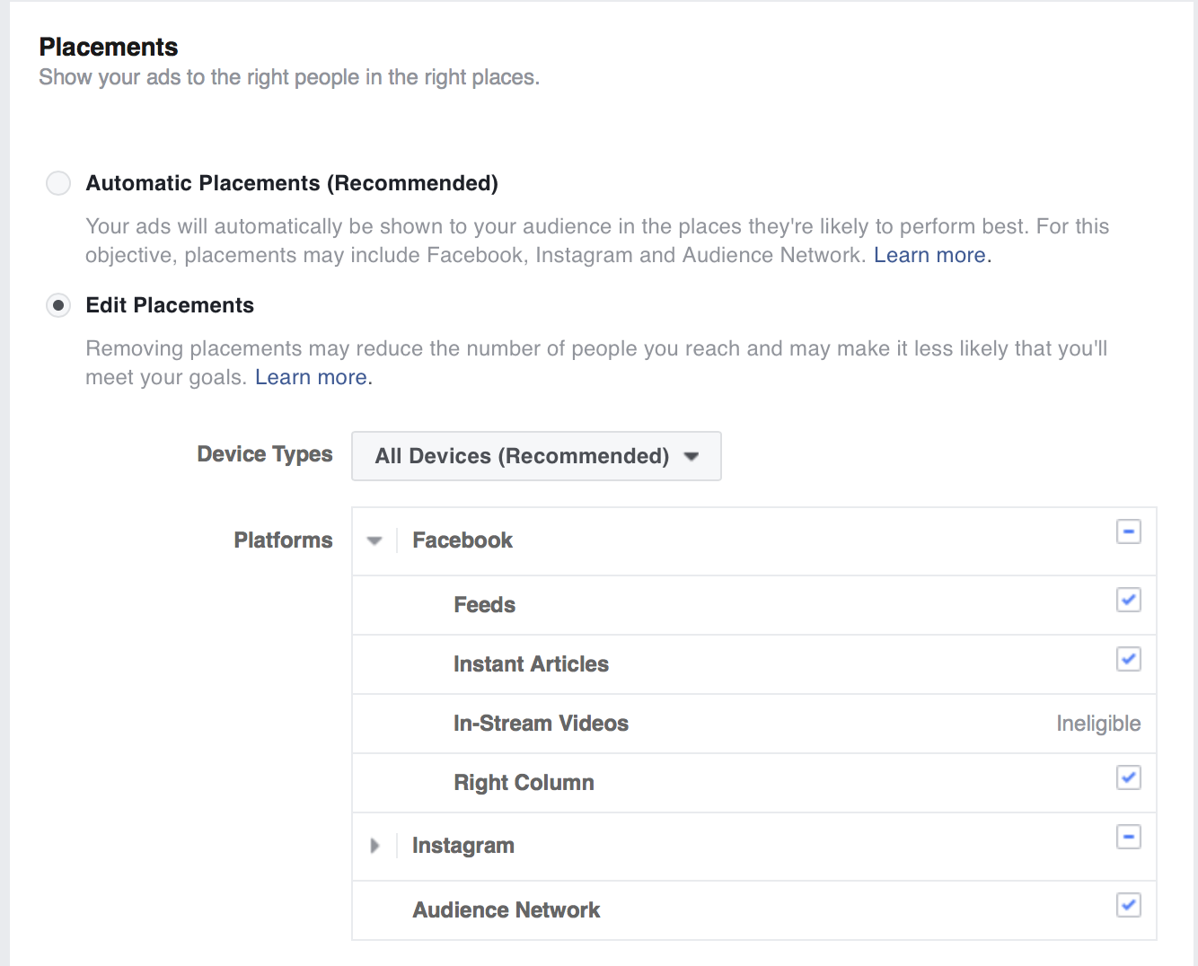
Step 4: Set up Ad Audience
Brand awareness: Facebook and Instagram
Engagement: Facebook and Instagram
Video views: Facebook and Instagram
Traffic (for website clicks and app engagement): Facebook
Conversions: Facebook

Slide 22
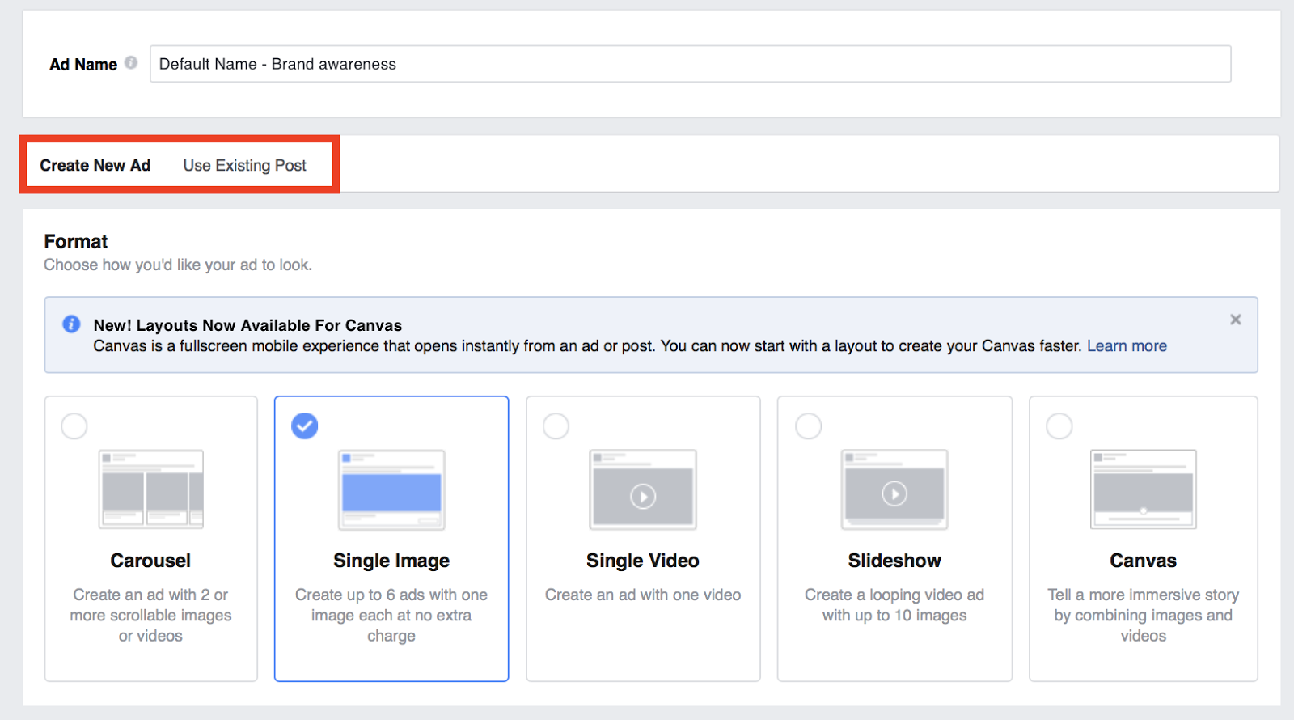
Step 4: Set up Ad
After paying for the ad you can then set up the preferred display

Slide 23
Summary
Keep things brief
Always have the next event pinned to the top of the Facebook page. ALWAYS
When making an ad really take the time to plan out the three keys:
  central message, target audience, & call to action
Focus on perfecting the media used for the events and ads
The basics to remember

